Slide 1

Capstone Project
AWS TWITTER STREAMING DATA ANALYSIS
GROUP E
Nikita, Pulkit, Zarna, Yasin, Deep
Submitted on
November 5th, 2022

Slide 2
Objective
In this project, we made use of streaming tweets data from Twitter, and build a batch ETL pipeline, to ingest stream, store, transform and load the results
The outcome of the project is to build a user-friendly dashboard to allow users to analyze the trends of stock market-related tweets.

Slide 3

TECH STACK (AWS SERVICES)
EXTRACT – Kinesis | AWS ECS & ECR
TRANSFORM – Lambda | Glue ETL |Catalog | Workflow
LOAD – S3 | DynamoDB
SHOW – ECS for deployment

Slide 4
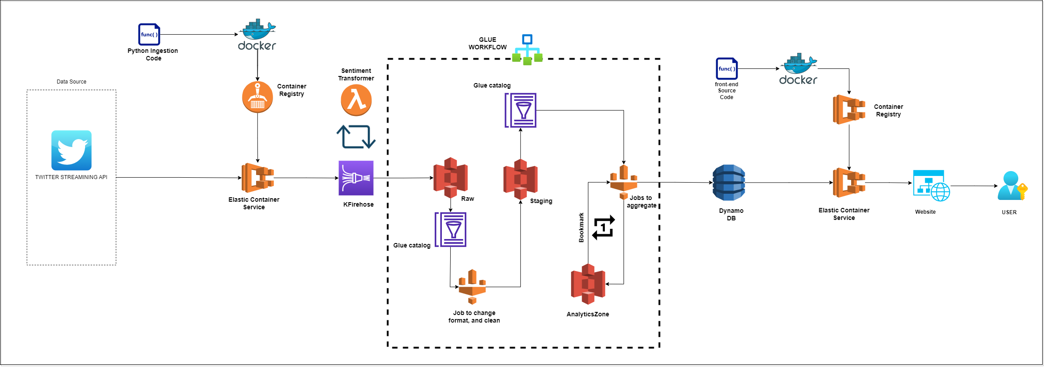
Architecture DIAGRAM
Extract
Transform
Load

Slide 5


Let’s understand each of the pieces

Slide 6

Piece 1-A – Understanding key services
Docker
Helps to containerize the code, and run it anywhere
AWS Container Registry
Stores the docker image for use inside AWS, just like Docker Hub
Elastic Container Service (ECS)
Allows to deploy docker images as Tasks, and Services

Slide 7
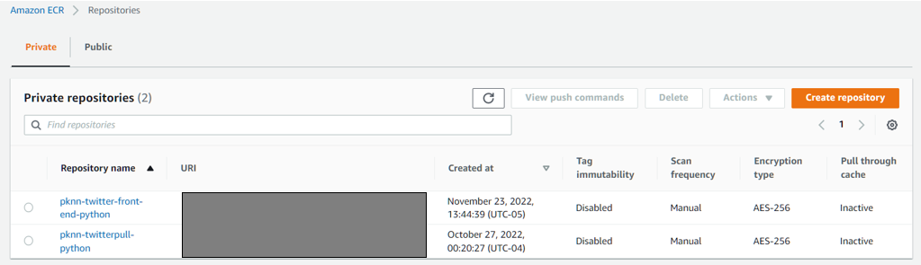
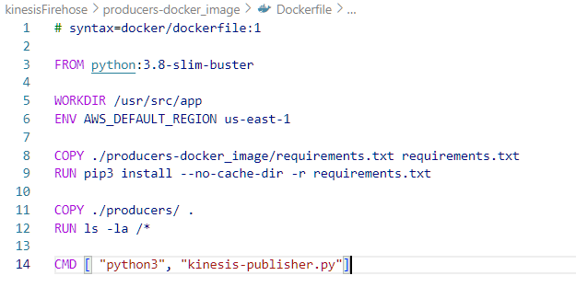


Fig1: Docker images for front-end code and Tweet ingestion code
Fig2: Example of Docker file: used to build docker image
DOCKER

Slide 8
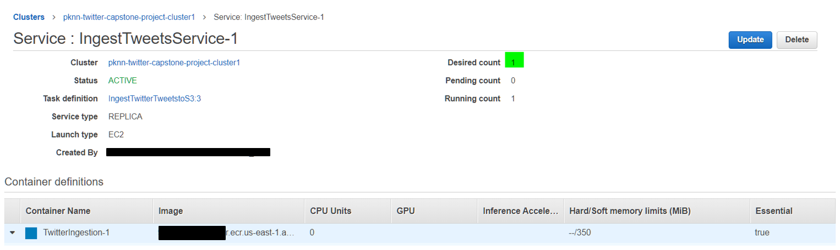

Fig3: Service created in ECS to ingest tweet stream and store to S3
ECS Container service

Slide 9
Piece 1-B – Understanding key services
Kinesis Firehose
Ingest high velocity streaming data
Deliver data to variety of data targets like DBs, S3, Redshift etc.
Lambda Function
Serverless compute
Develop code without thinking about servers

Slide 10
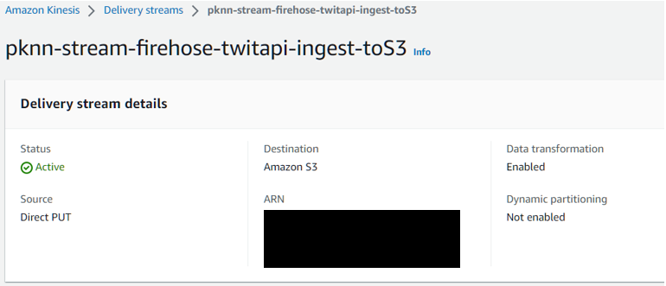
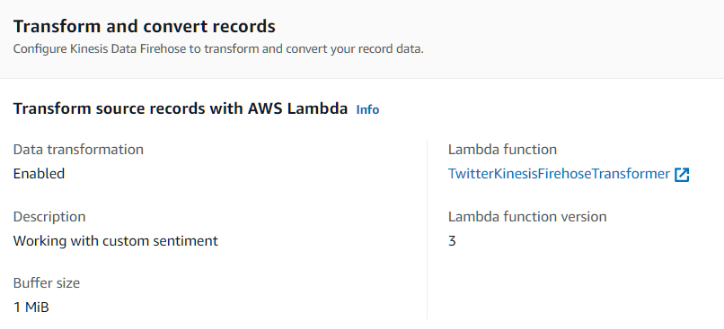

Fig4: Kinesis Firehose to deliver data to the configured S3 location
Fig5: Lambda function to transform incoming tweets
KINESIS FIREHOSE

Slide 11
Piece 1 – Overall
Python | Docker | ECR/ECS
We are extracting tweets using Twitter streaming API
Data extraction code is deployed as a Docker image in AWS Docker registry (ECR)
We deploy a service to continuously extract the stream
Kinesis | Lambda Fxn
Data extracted is delivered to Kinesis Firehose
Lambda transforms each record to attach sentiment

Slide 12
Piece 2-A – Understanding key services
AWS S3
Storage layer to store any kind of files as objects into user created buckets (flat storage)
Crawlers & Catalog - Glue
Allows to generate meta-data about data in datastores like S3
Spark ETL - Glue
Write logic to transform and clean data
Workflow - Glue
Orchestrate and schedule different steps like:
Update catalog
Run Spark ETL

Slide 13
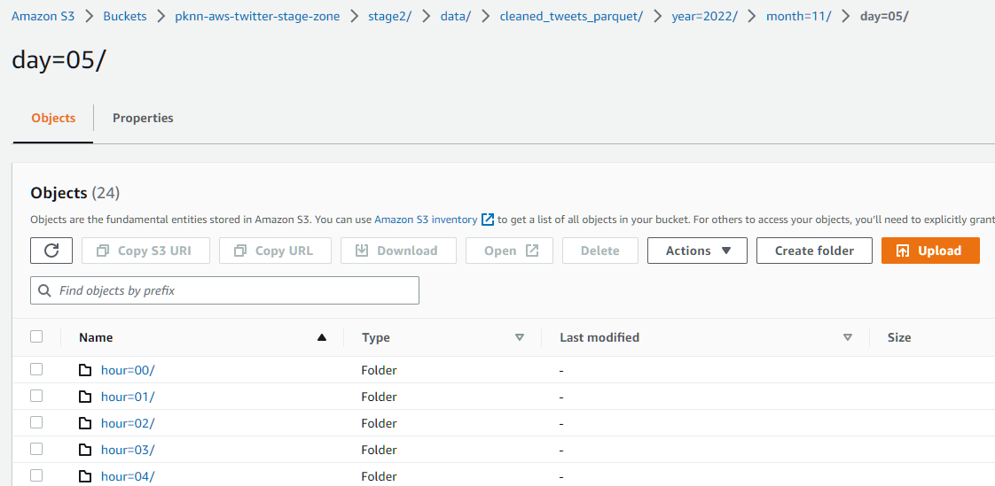
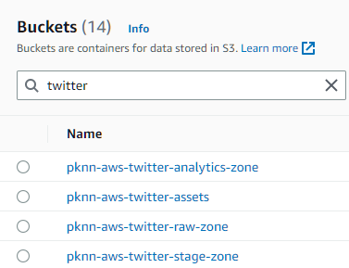
Fig6: Buckets created for different ETL stages
Fig7: Data is partitioned at the Year-Month-Day-Hour level
AWS s3

Slide 14
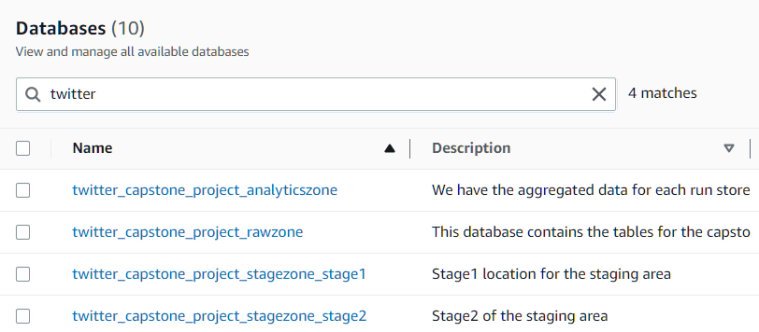
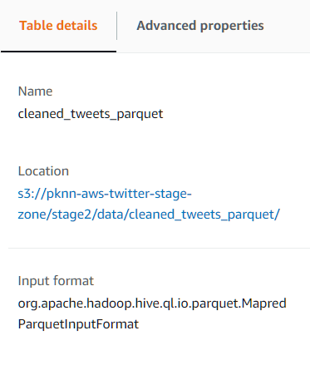

Fig8: Glue Databases for different stages in ETL: Raw, Stage1, Stage2, and Analytics
Fig9: Example: Stage 2 table with S3 location specified
crawler & catalog

Slide 15
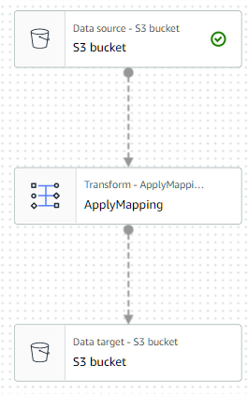

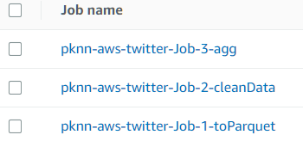
SPARK
Apache spark is open-source system used for big data workloads
Allows in-memory processing of big data on distributed clusters
Allows development of ETL jobs in many languages like Python, Scala, Java
Our ETL consists of 3 Jobs, with functions to –
Change Data Format
Clean the data
Aggregate the data
SPARK ETL - GLUE

Slide 16
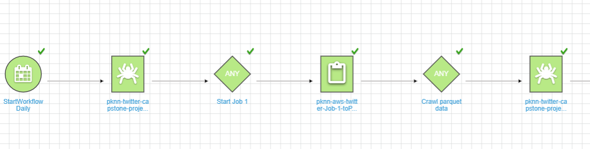
Fig10: Glue Workflow – Triggers crawlers and ETL jobs in sequence/flow
WORKFLOW- GLUE

Slide 17
Piece 2 – key details
Glue Pyspark ETL
All data is processed incrementally: same data is not processed twice
Using feature of Glue called Bookmarks
Glow Workflow
Data is processed in batches
Schedule of workflow is to set to run once a day

Slide 18
Piece 3-A – Understanding key services
DynamoDB
Fully managed serverless NoSQL database
Supports key-value structures
Can support tens of million of read and write requests per second
Python Stremlit
Open-source app framework in Python language
Helps to quickly build data science dashboards in python

Slide 19

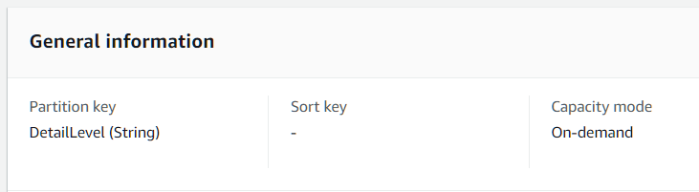
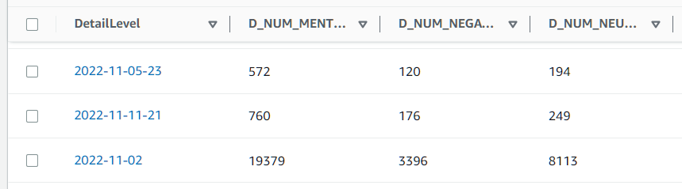
DynamoDB
Every table has a partition key and an optional range key
Example – DetailLevel on left
Fig11: Example – Table we have used for the leaderboard view showing the ranking of Tickers
Dynamo-db

Slide 20

Front-End DEsign

Slide 21
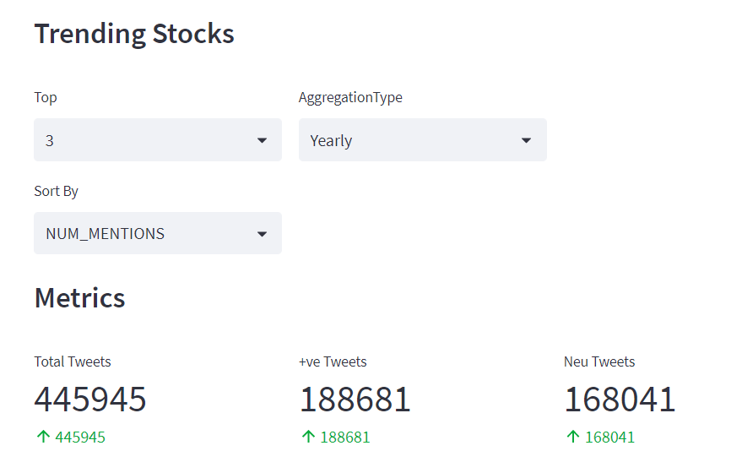
View-1 overall metrics

Slide 22
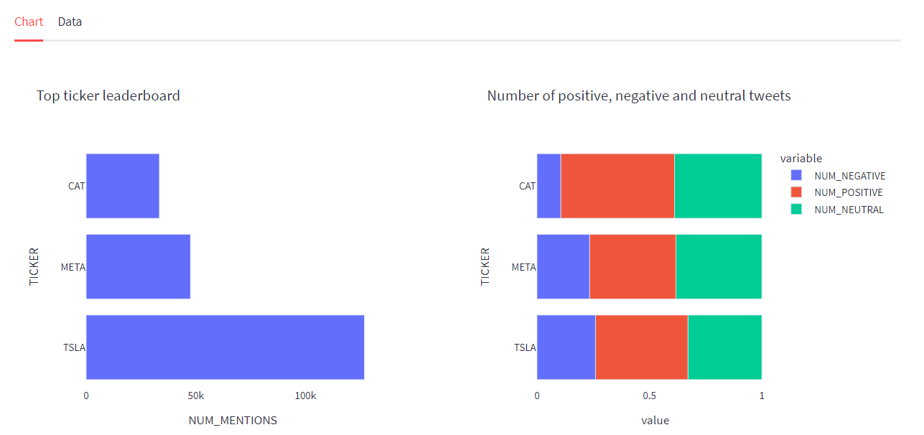
View-2 Leaderboard

Slide 23
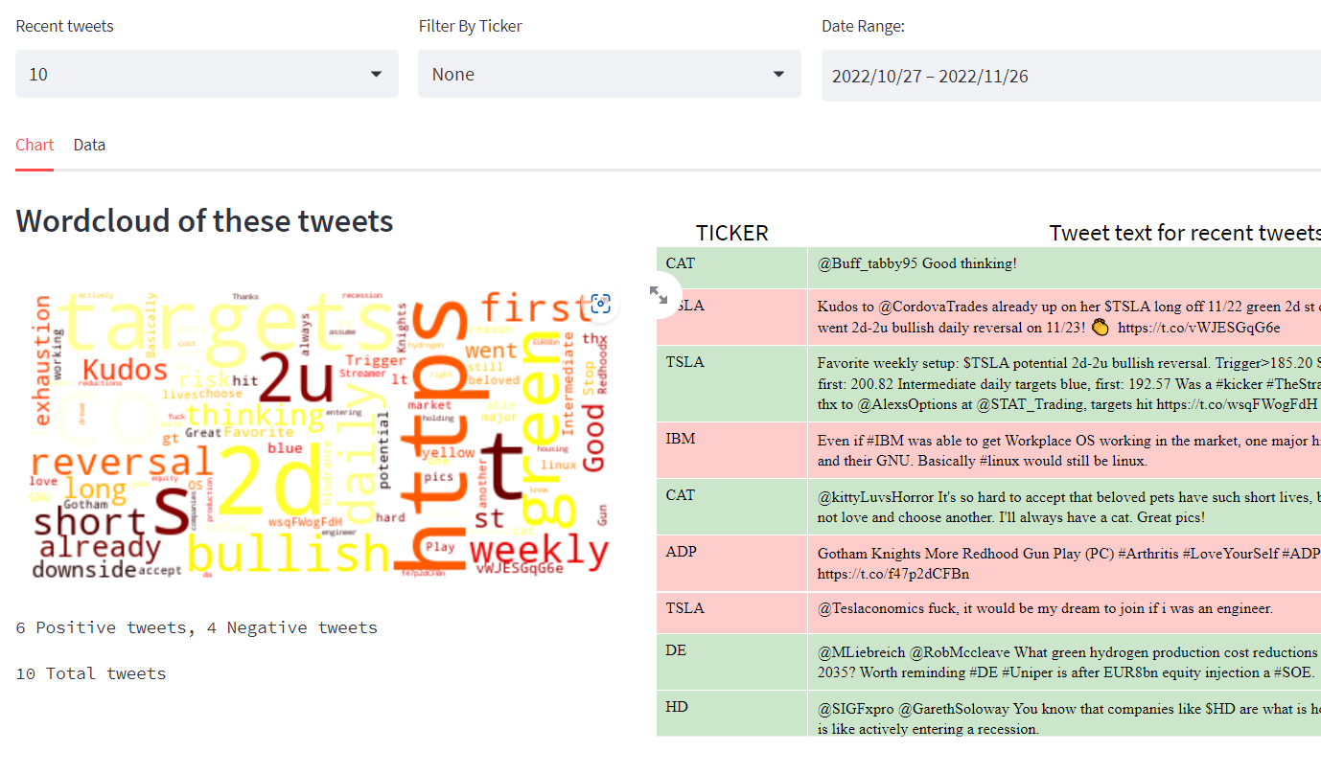
View-3 recent tweets

Slide 24
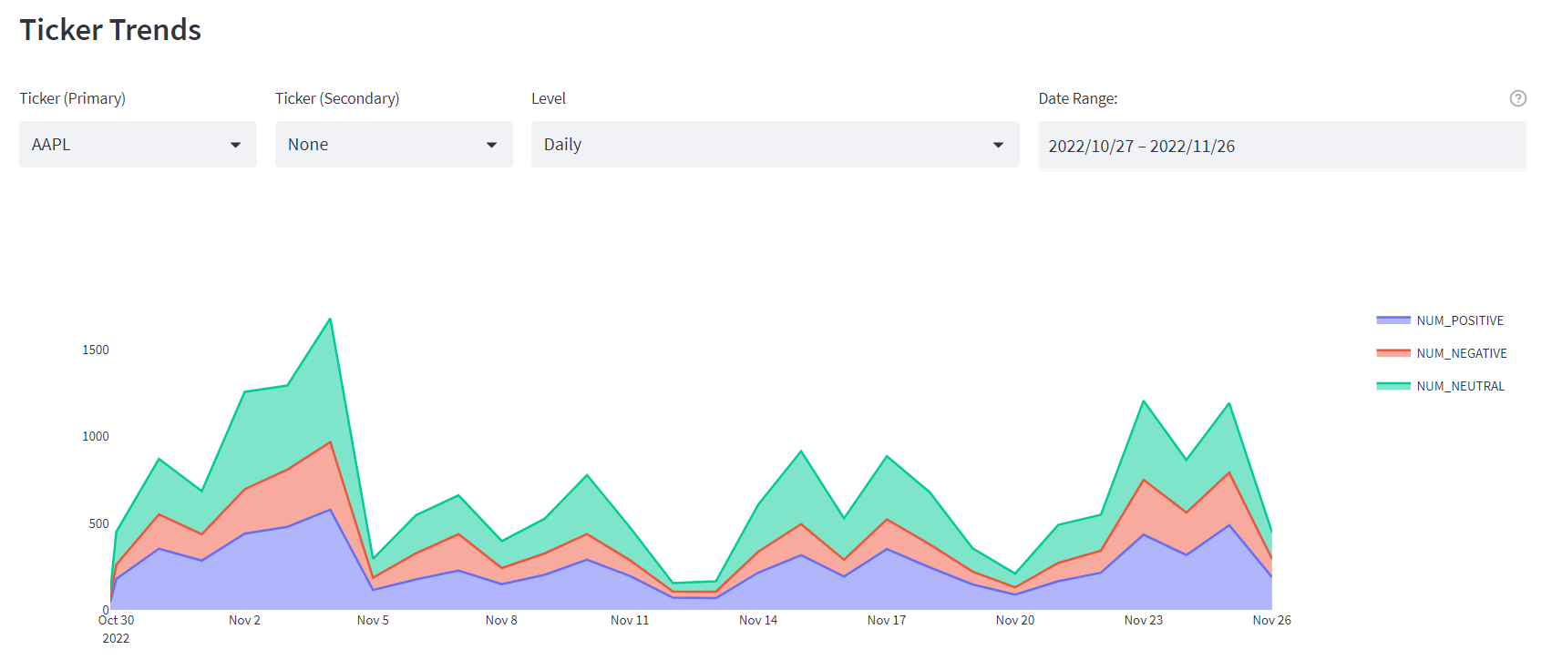
View-4 ticker trend

Slide 25
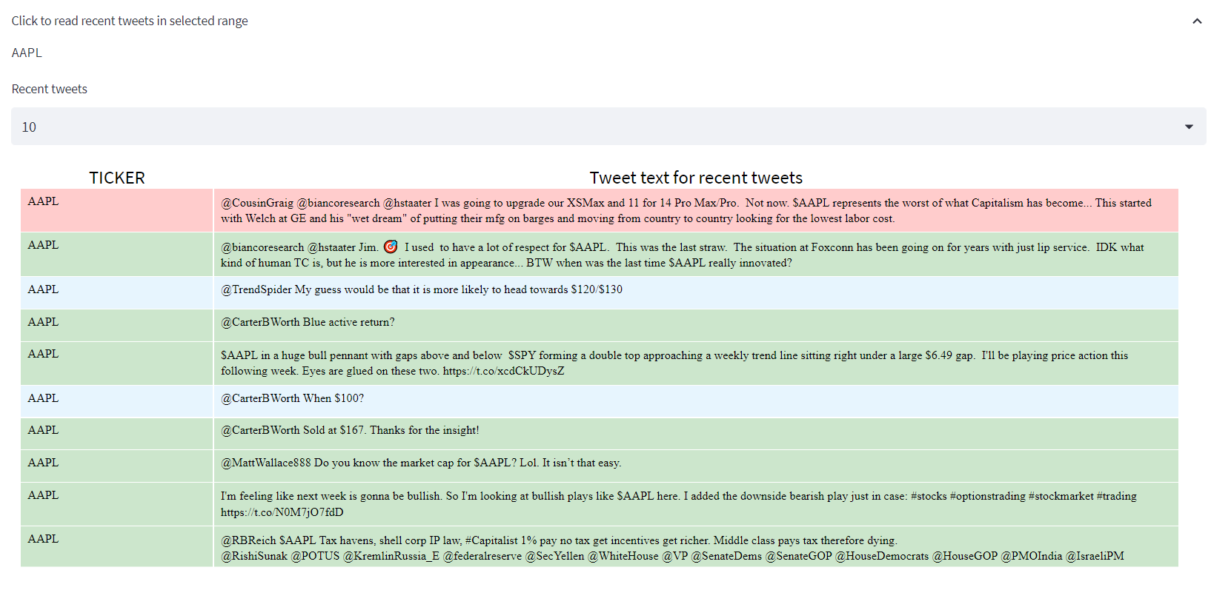
View-5 ticker tweets

Slide 26

dashboard link
ec2-3-84-15-57.compute-1.amazonaws.com:8080
Note – The website does not work on Cestar Network, use phone internet

Slide 27

Any questions ?

